Slide 1
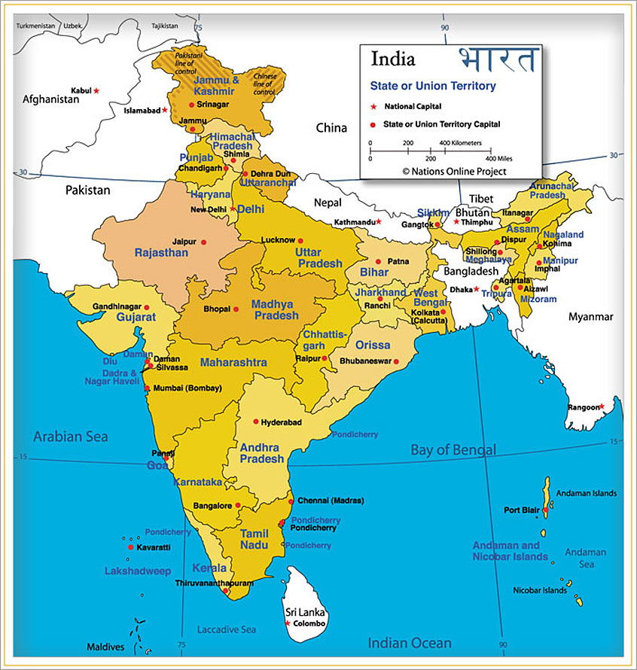
*Image
via
Bing

Slide 2
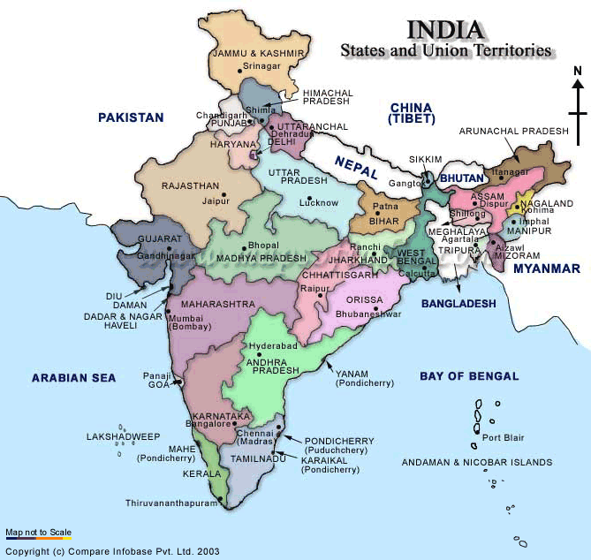
*Image
via
Bing

Slide 3
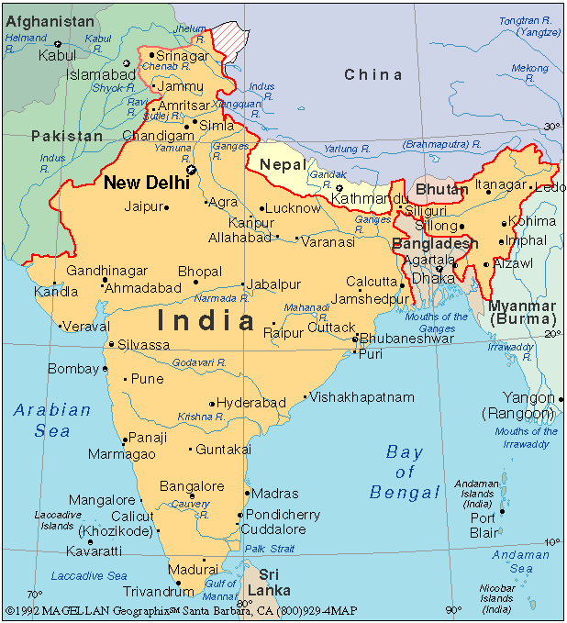
*Image
via
Bing

Slide 4
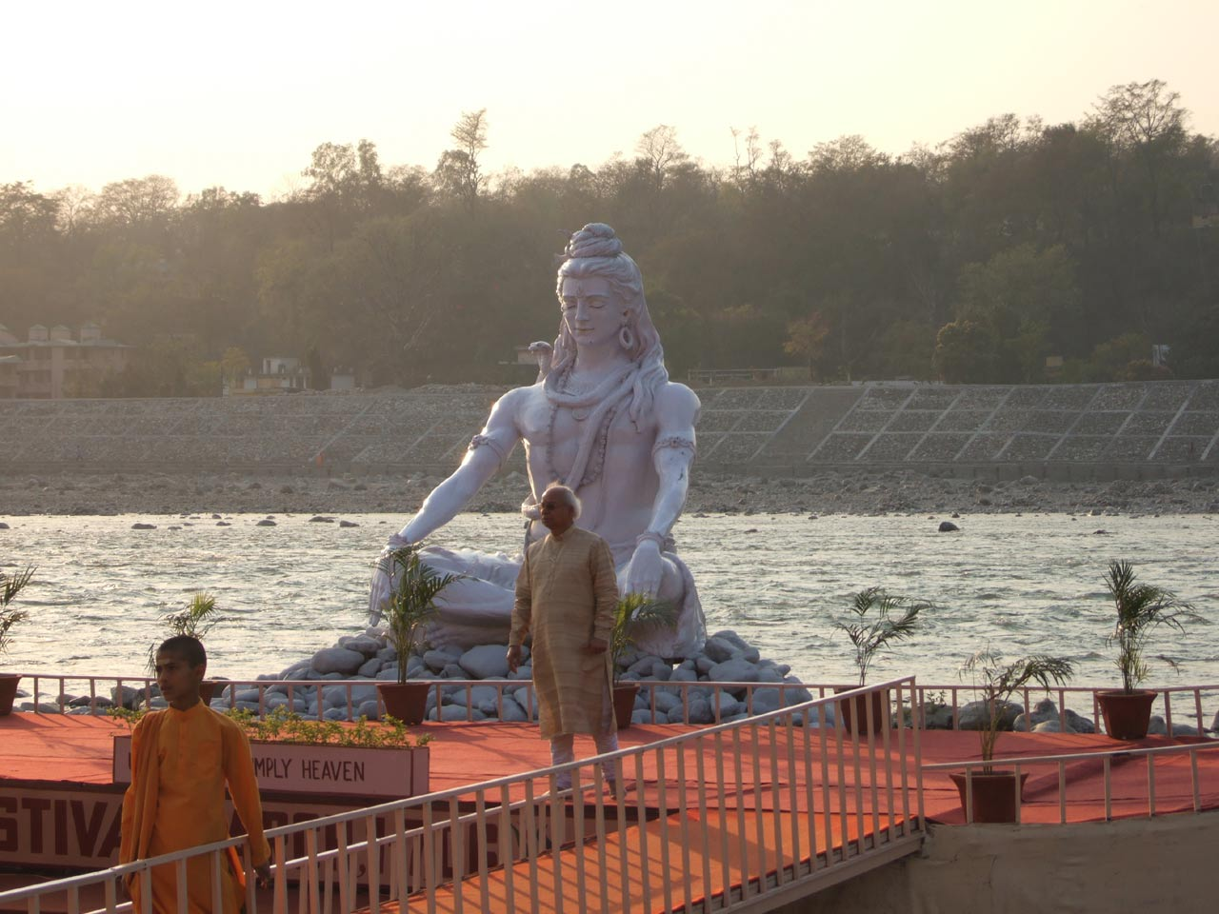
*Image
via
Bing

Slide 5
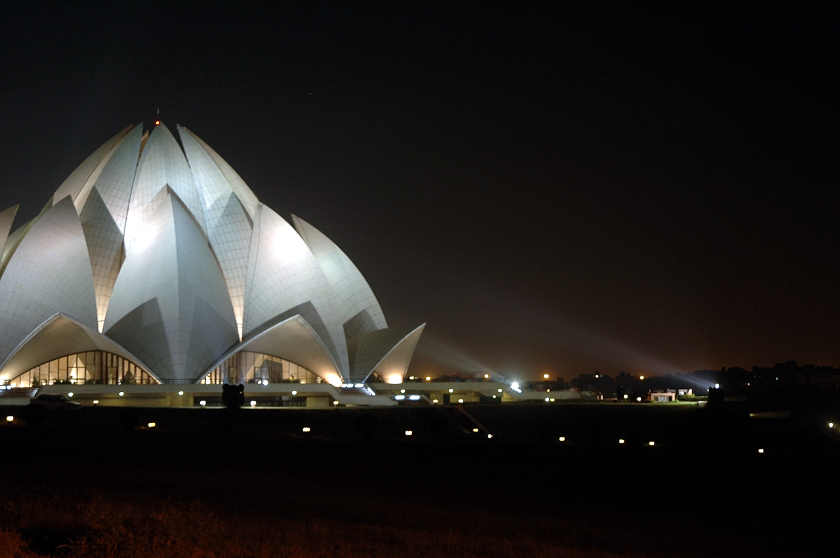
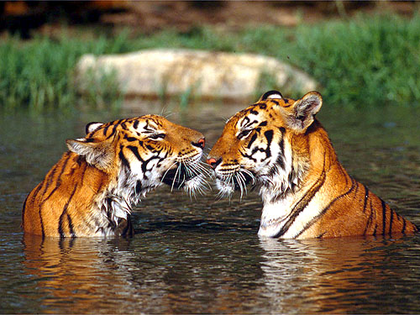
*Image
via
Bing
*Image
via
Bing

Slide 6
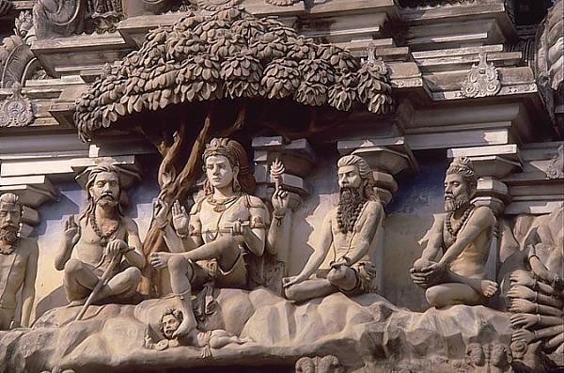
*Image
via
Bing

Slide 7
*Image
via
Bing

Slide 8

*Image
via
Bing

Slide 9

*Image
via
Bing

Slide 10
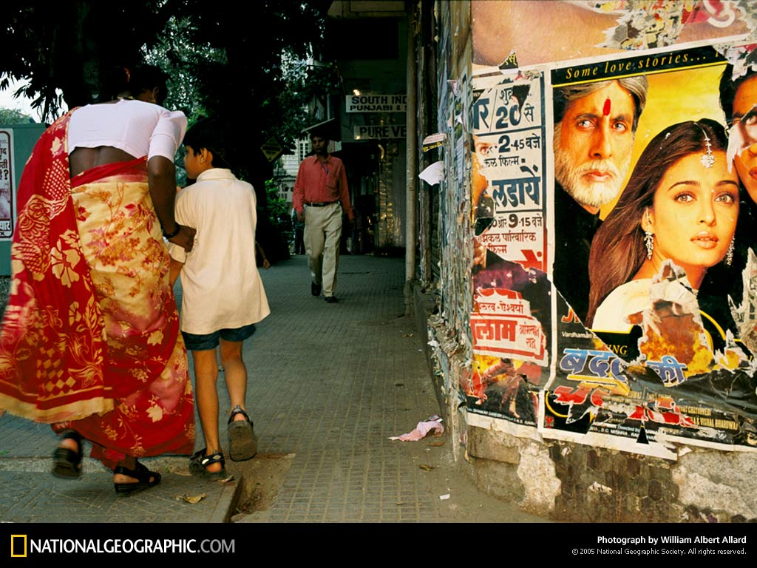
*Image
via
Bing

Slide 11
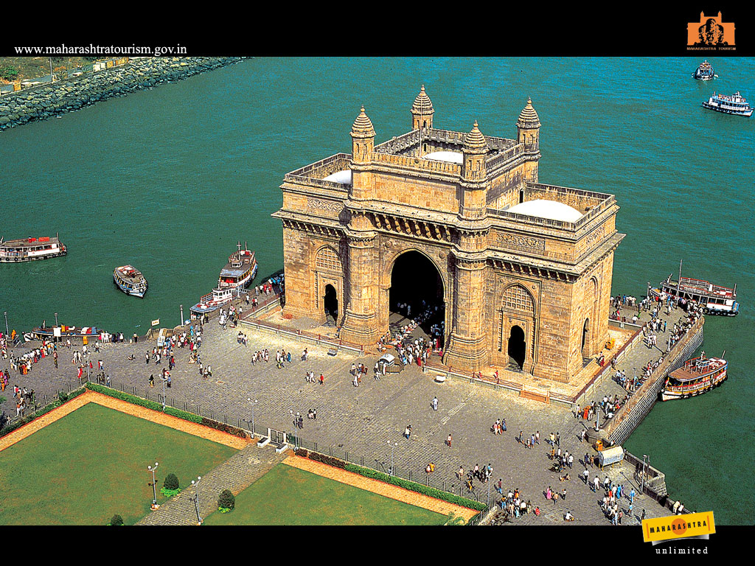
*Image
via
Bing

Slide 12
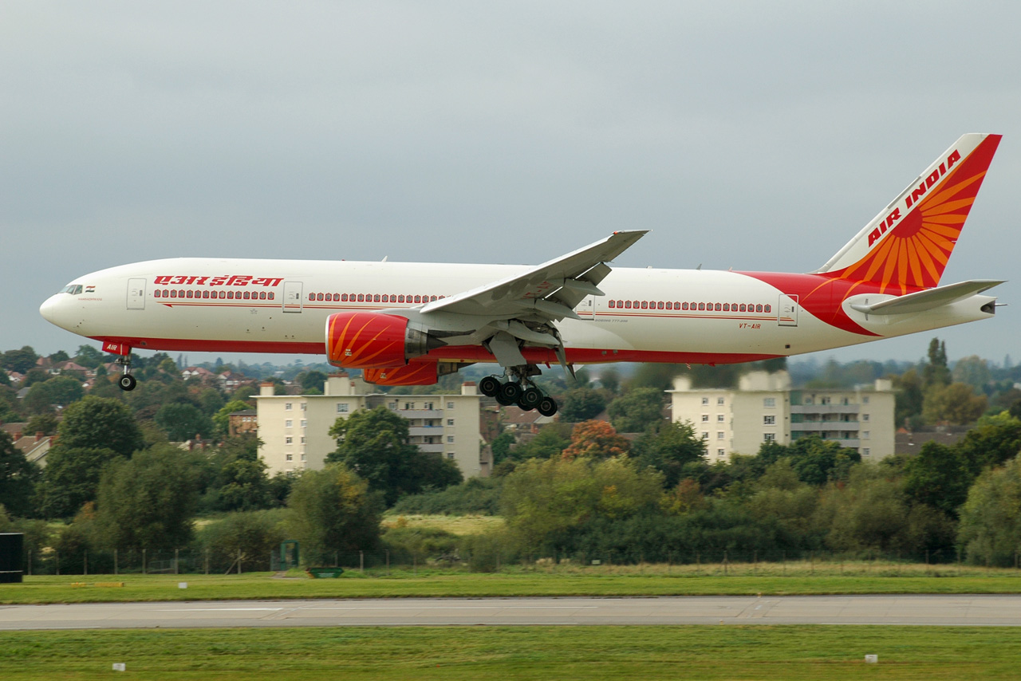
*Image
via
Bing

Slide 13
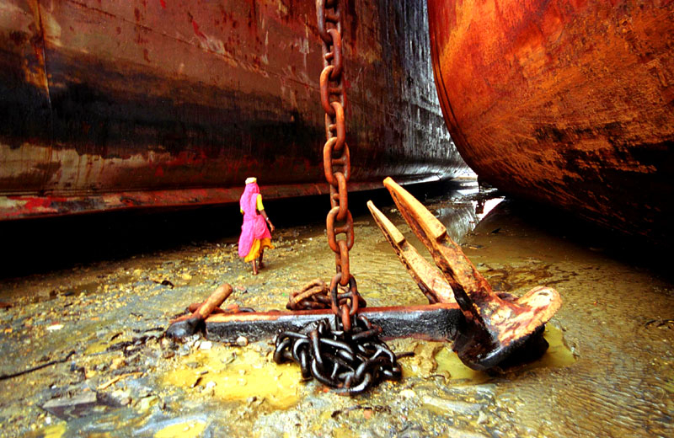
*Image
via
Bing

Slide 14
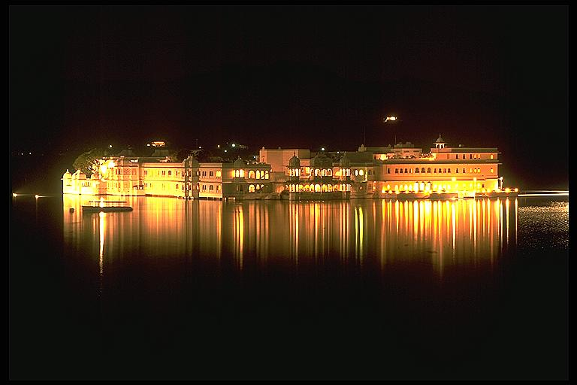
*Image
via
Bing

Slide 15

*Image
via
Bing

Slide 16

*Image
via
Bing

Slide 17
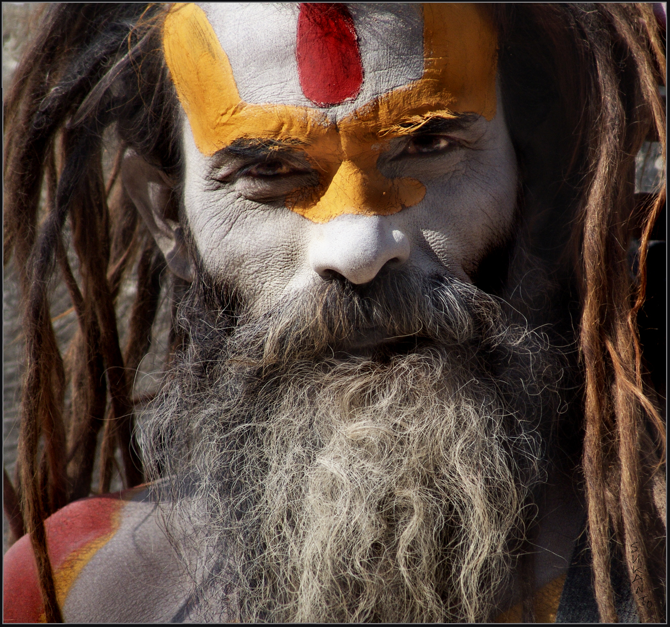
*Image
via
Bing

Slide 18
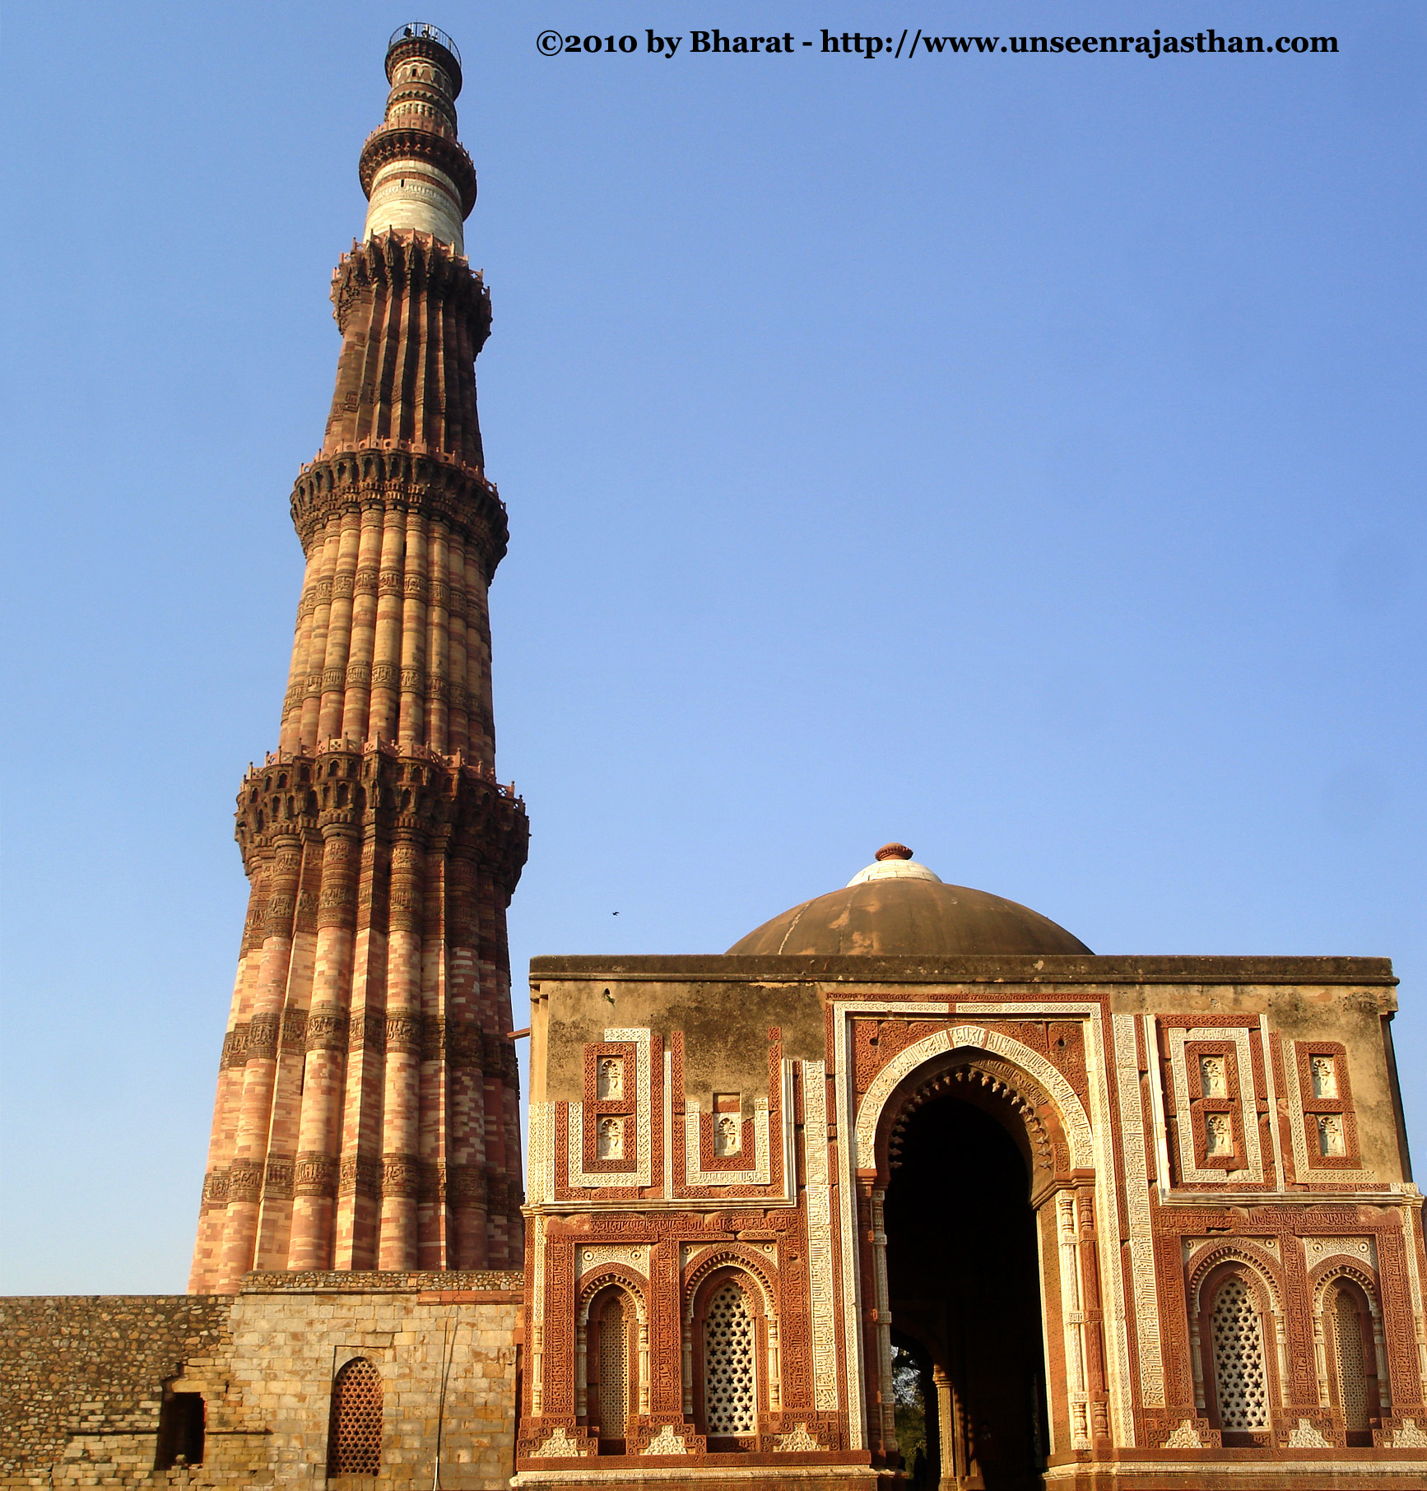
*Image
via
Bing

Slide 19
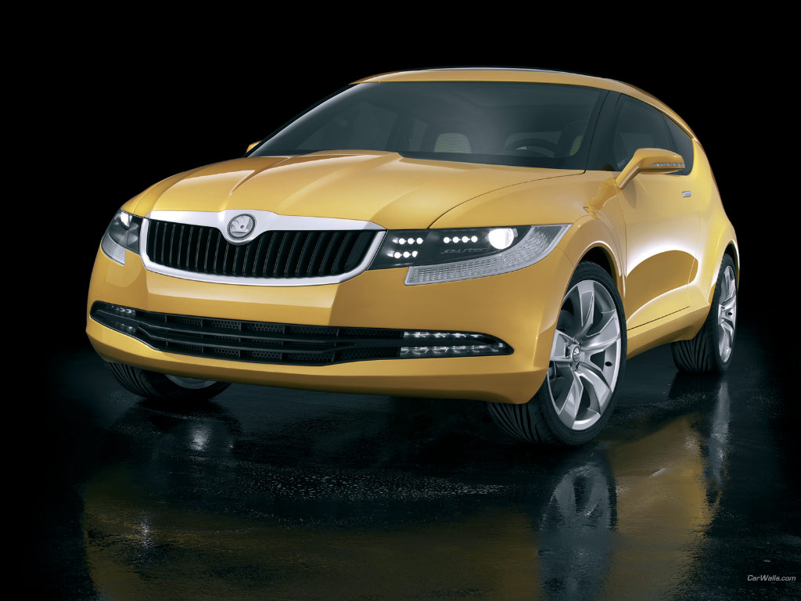
*Image
*Image
via
via
Bing
Bing

Slide 20
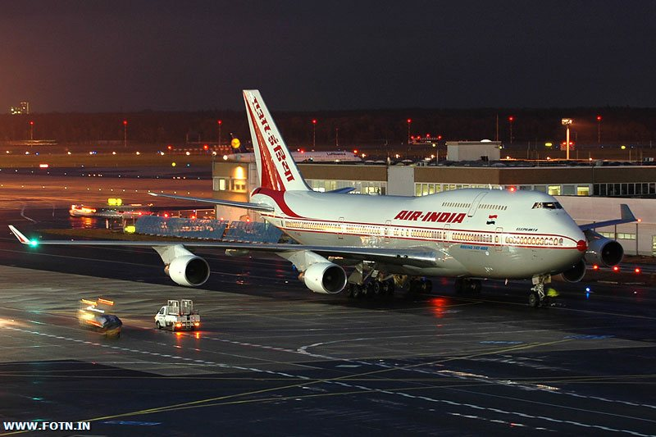
*Image
via
Bing

Slide 21
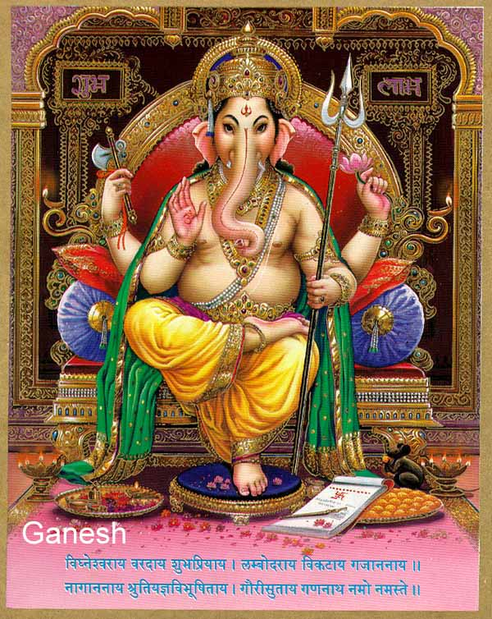
*Image
via
Bing
*Image
via
Bing

Slide 22
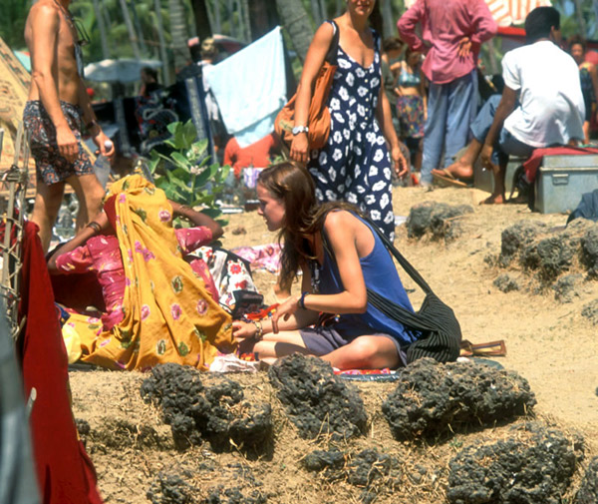
*Image
via
Bing

Slide 23
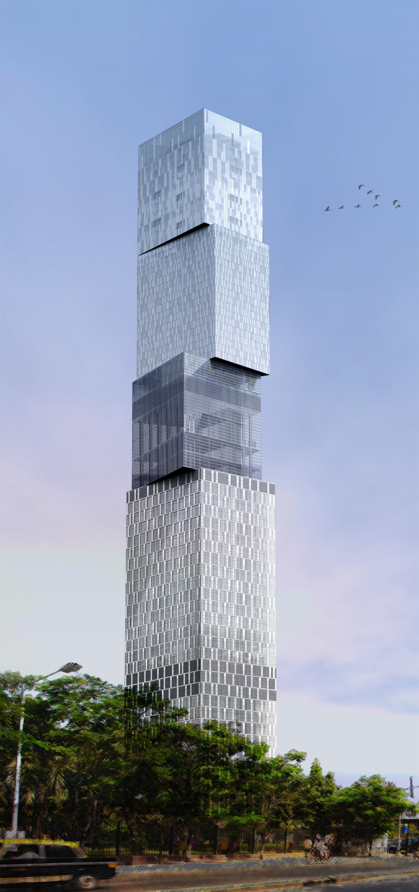
*Image
via
Bing

Slide 24
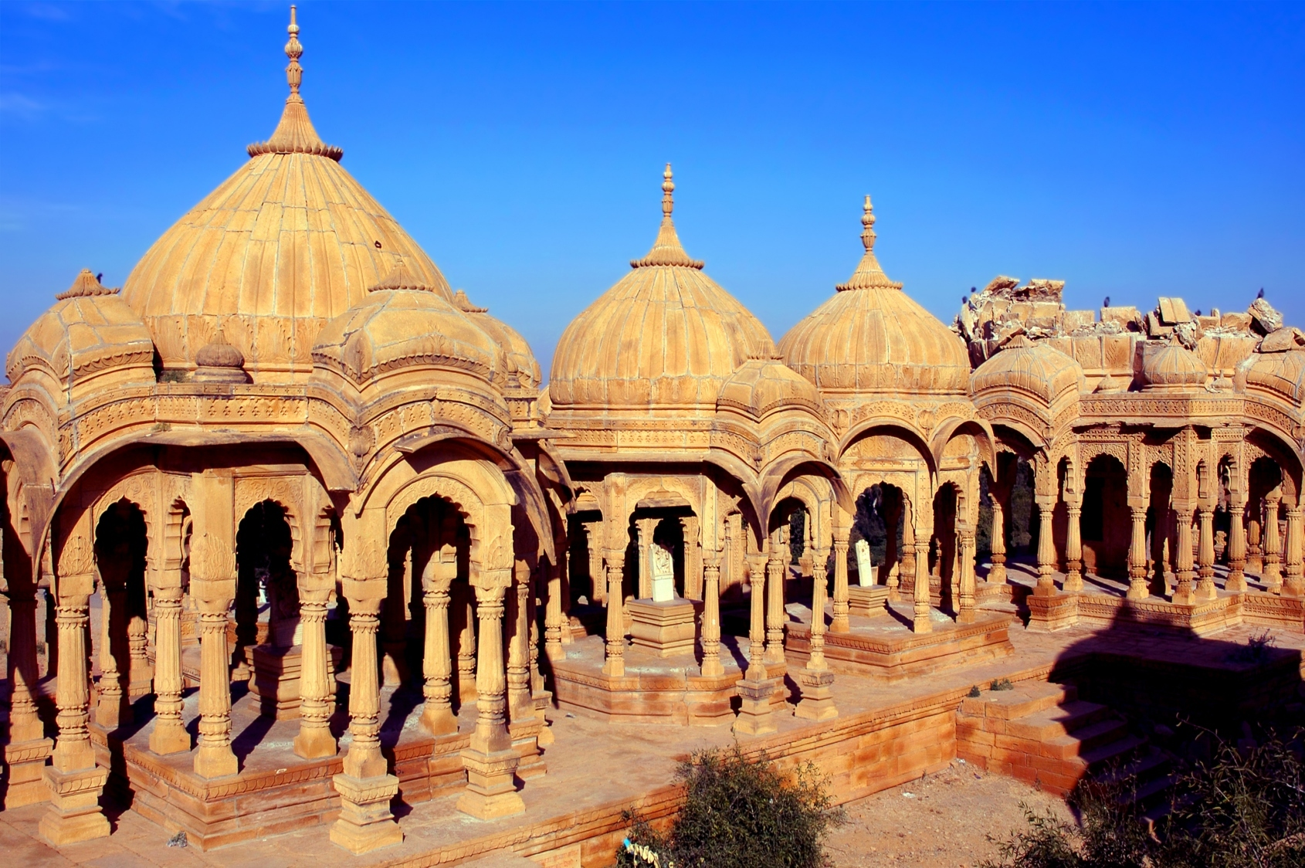
*Image
via
*Image
Bing
via
Bing

Slide 25
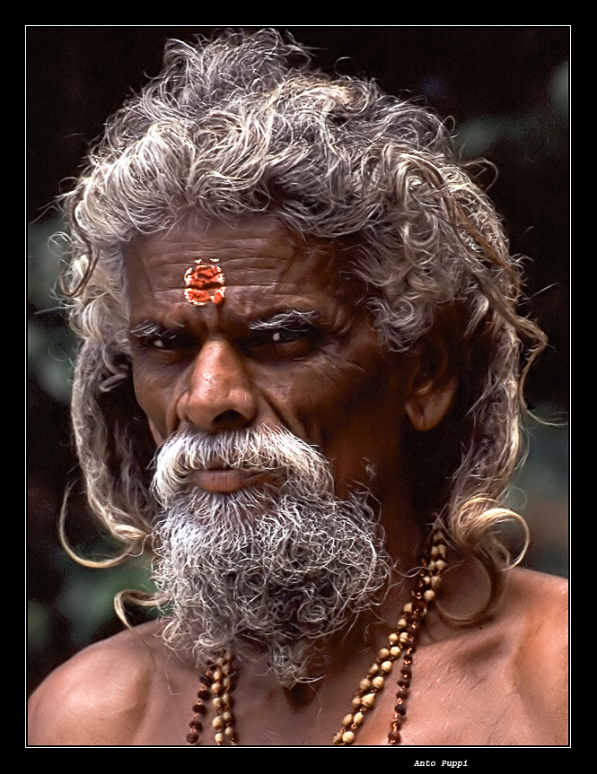
*Image
via
Bing

Slide 26
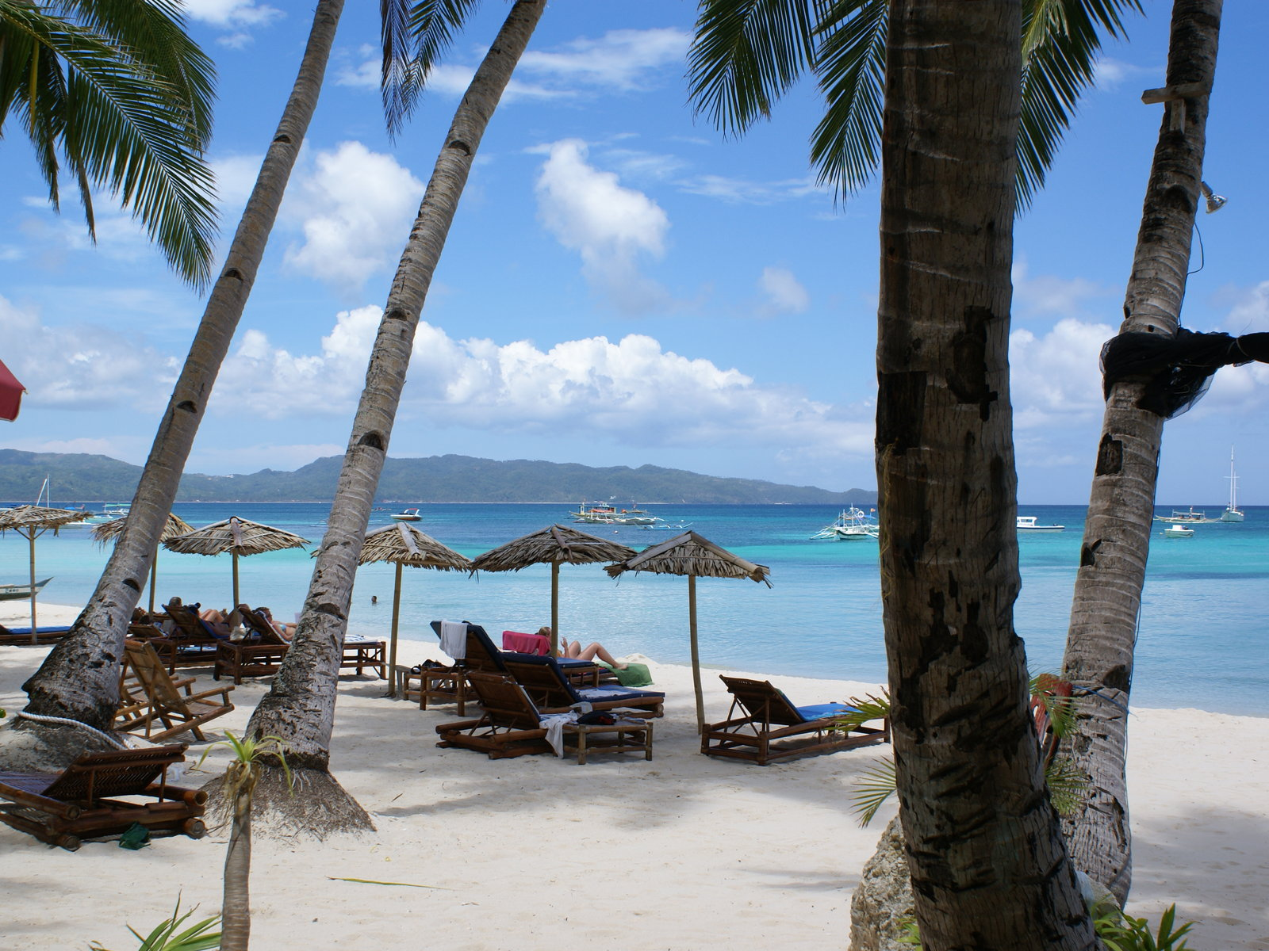
*Image
via
Bing

Slide 27
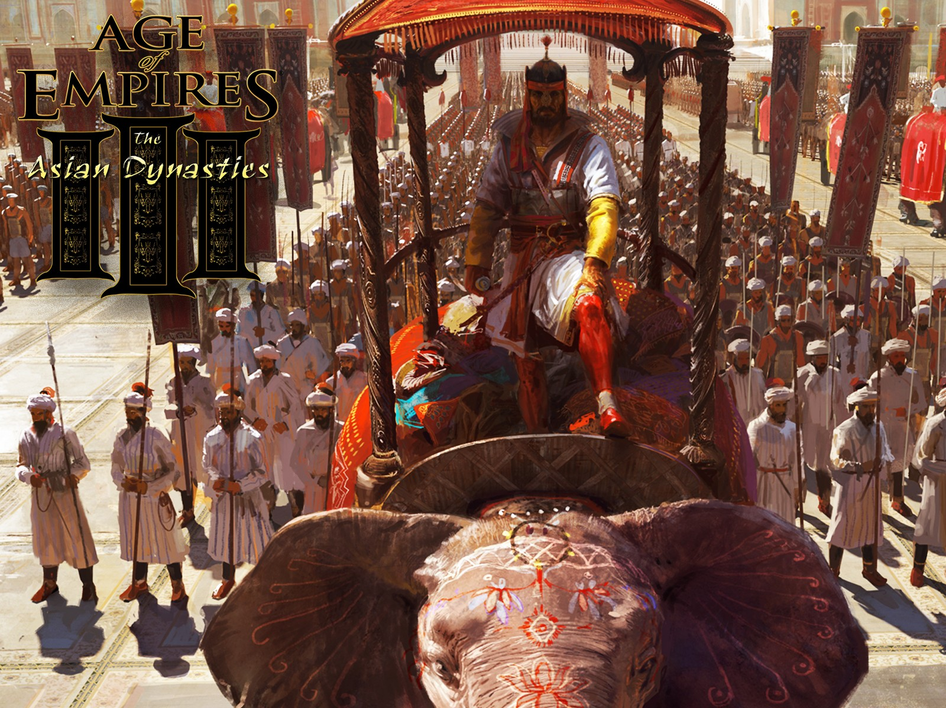
*Image
via
Bing

Slide 28
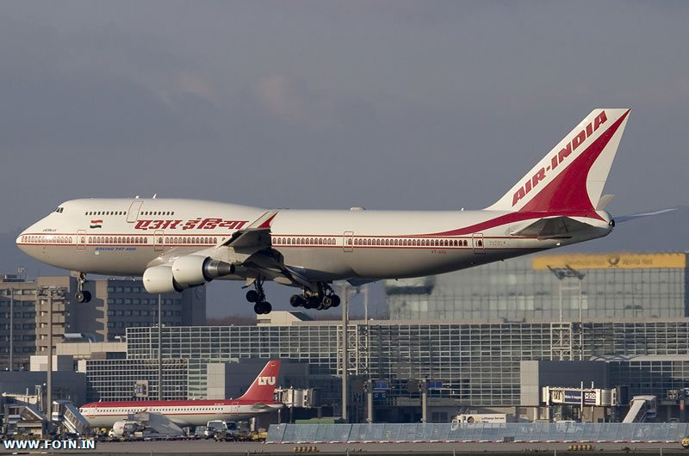
*Image
via
Bing

Slide 29
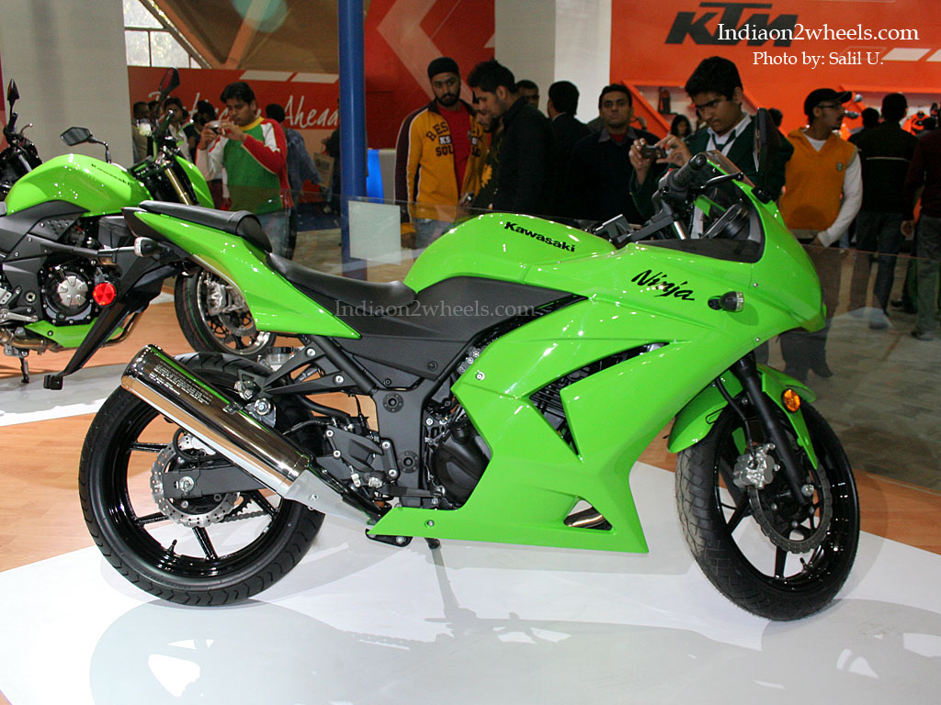
*Image
via
Bing

Slide 30
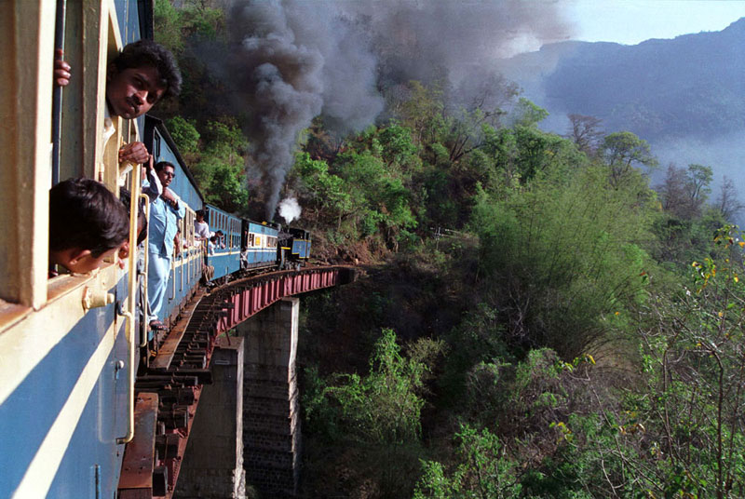
*Image
via
Bing

Slide 31
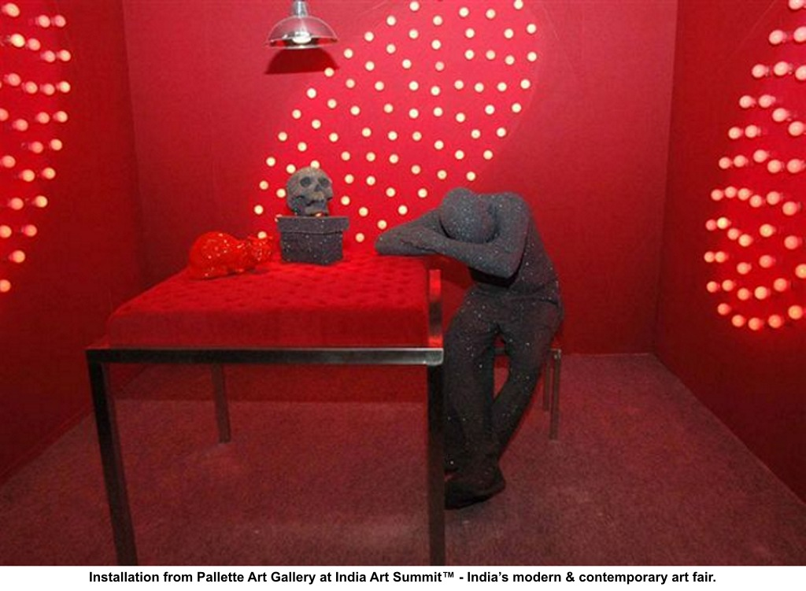
*Image
via
Bing

Slide 32

*Image
via
Bing

Slide 33
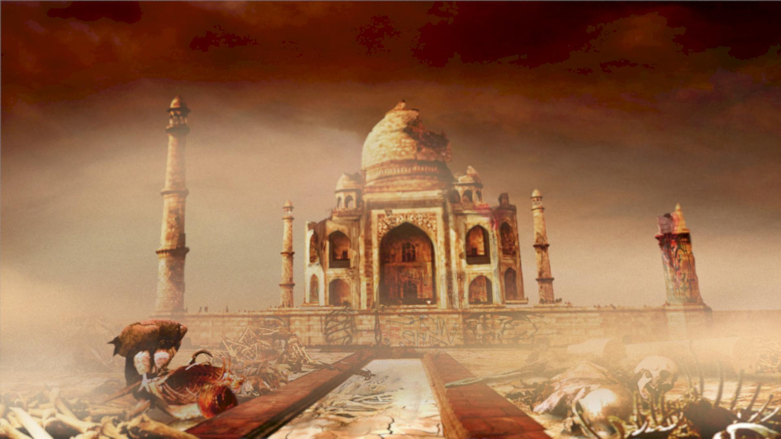
*Image
via
Bing

Slide 34
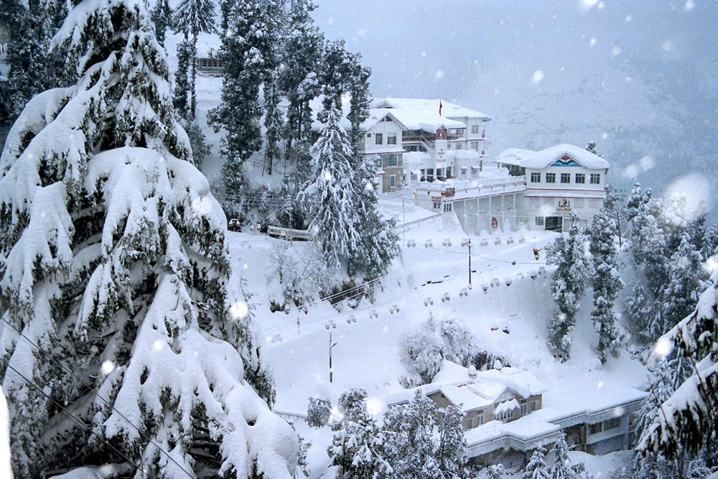
*Image
via
Bing

Slide 35

*Image
via
Bing

Slide 36
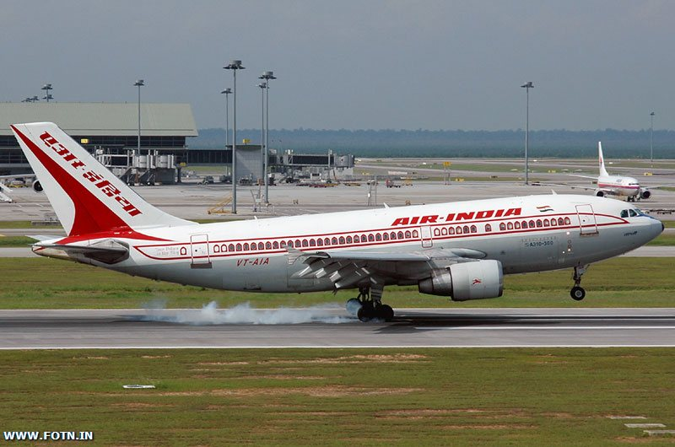
*Image
via
Bing

Slide 37
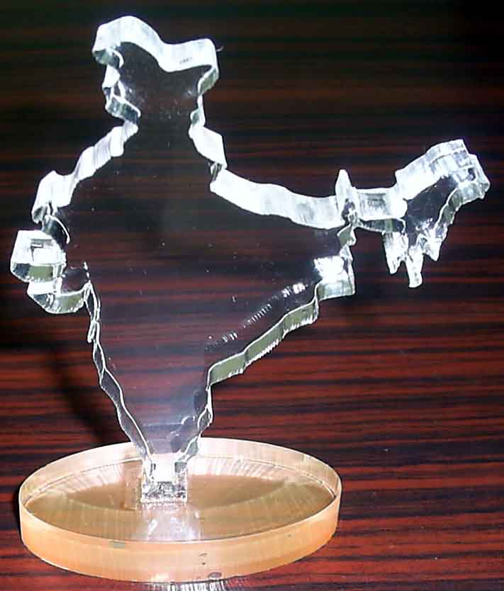
*Image
via
Bing

Slide 38
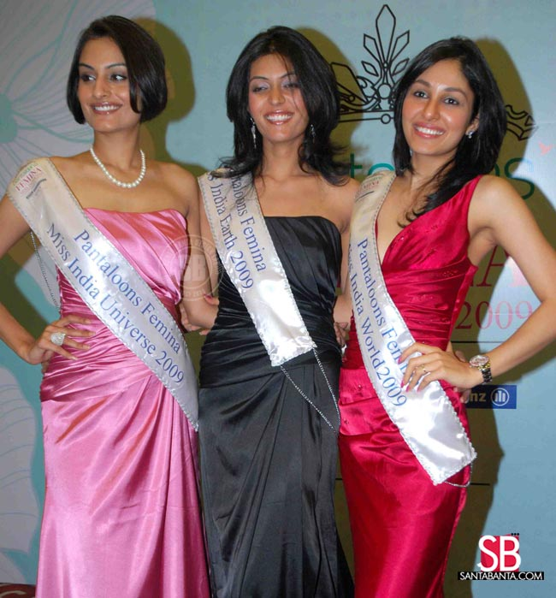
*Image
via
Bing

Slide 39
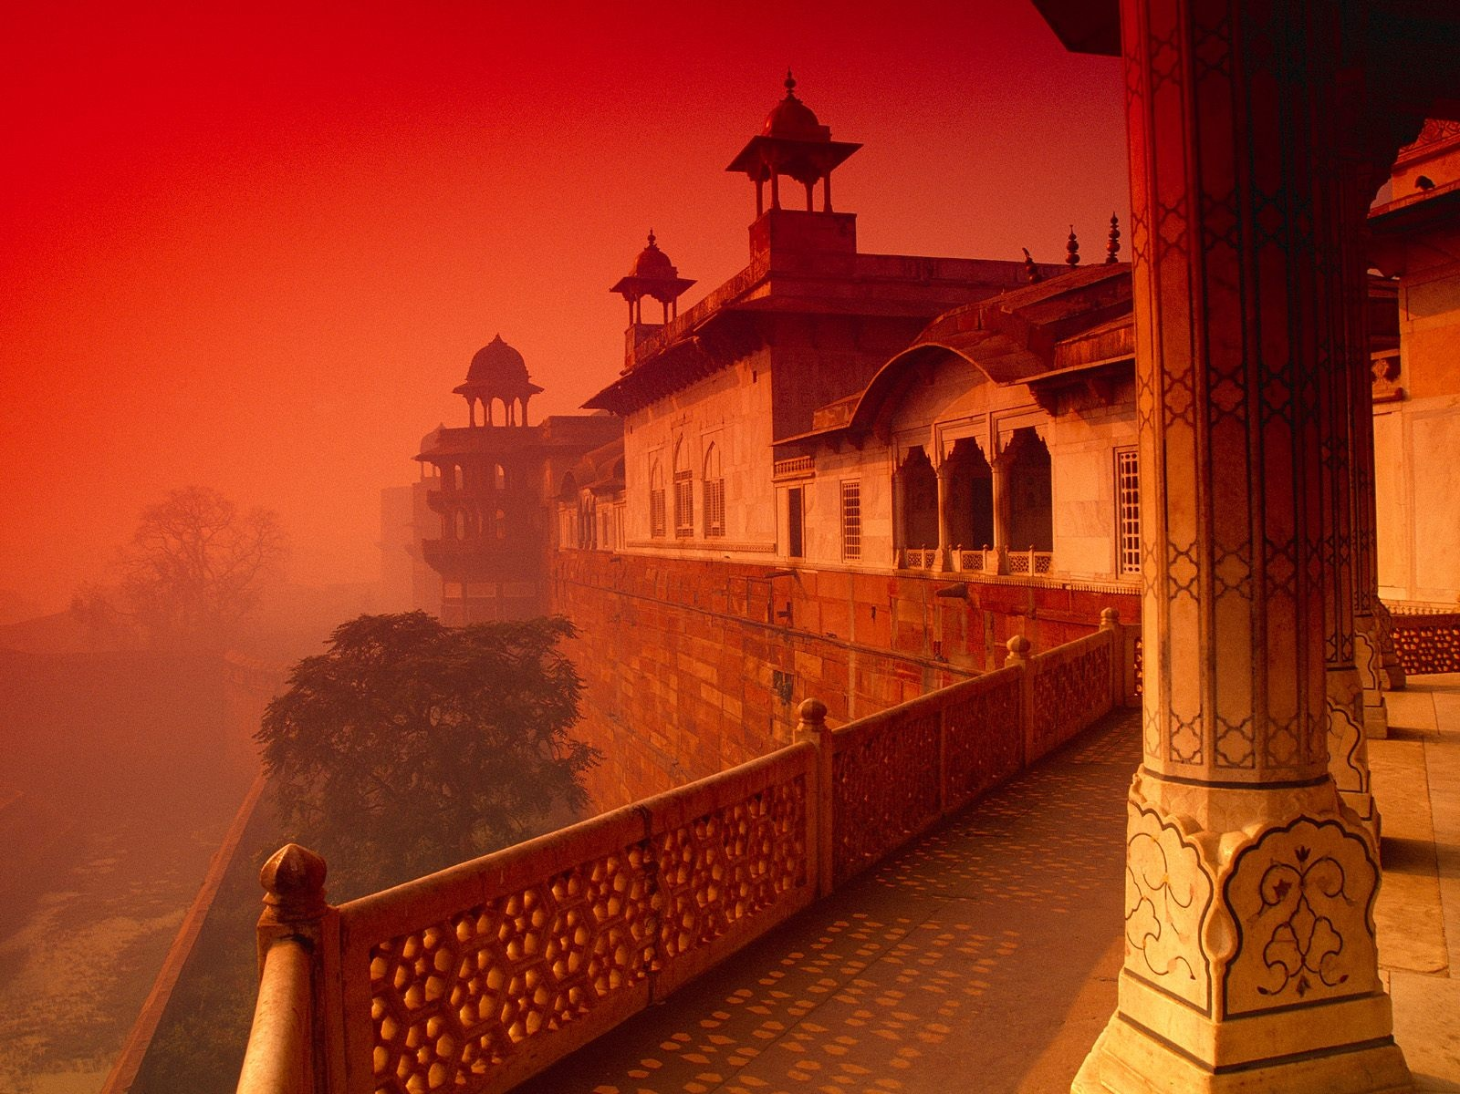
*Image
via
Bing

Slide 40
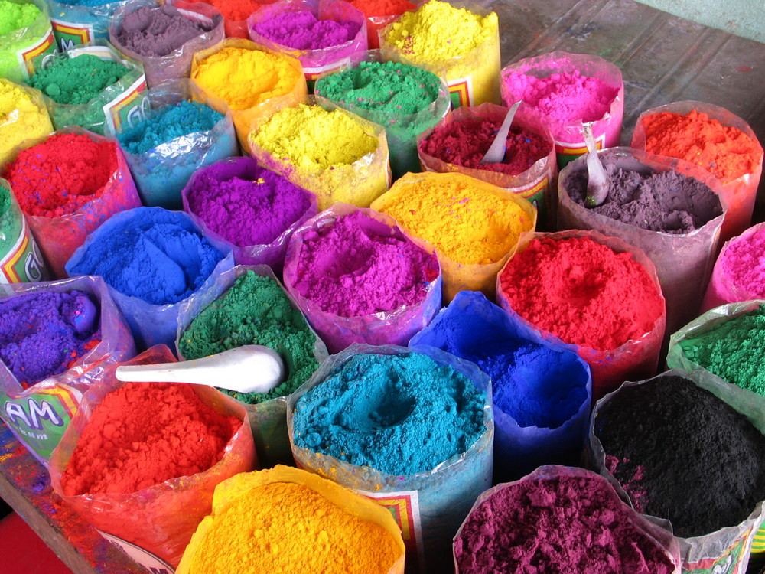
*Image
*Image
via
via
Bing
Bing

Slide 41
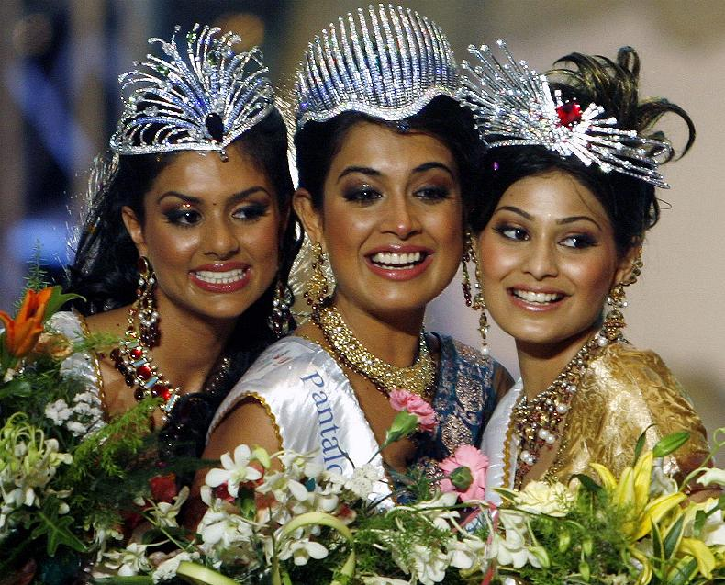
*Image
via
Bing

Slide 42
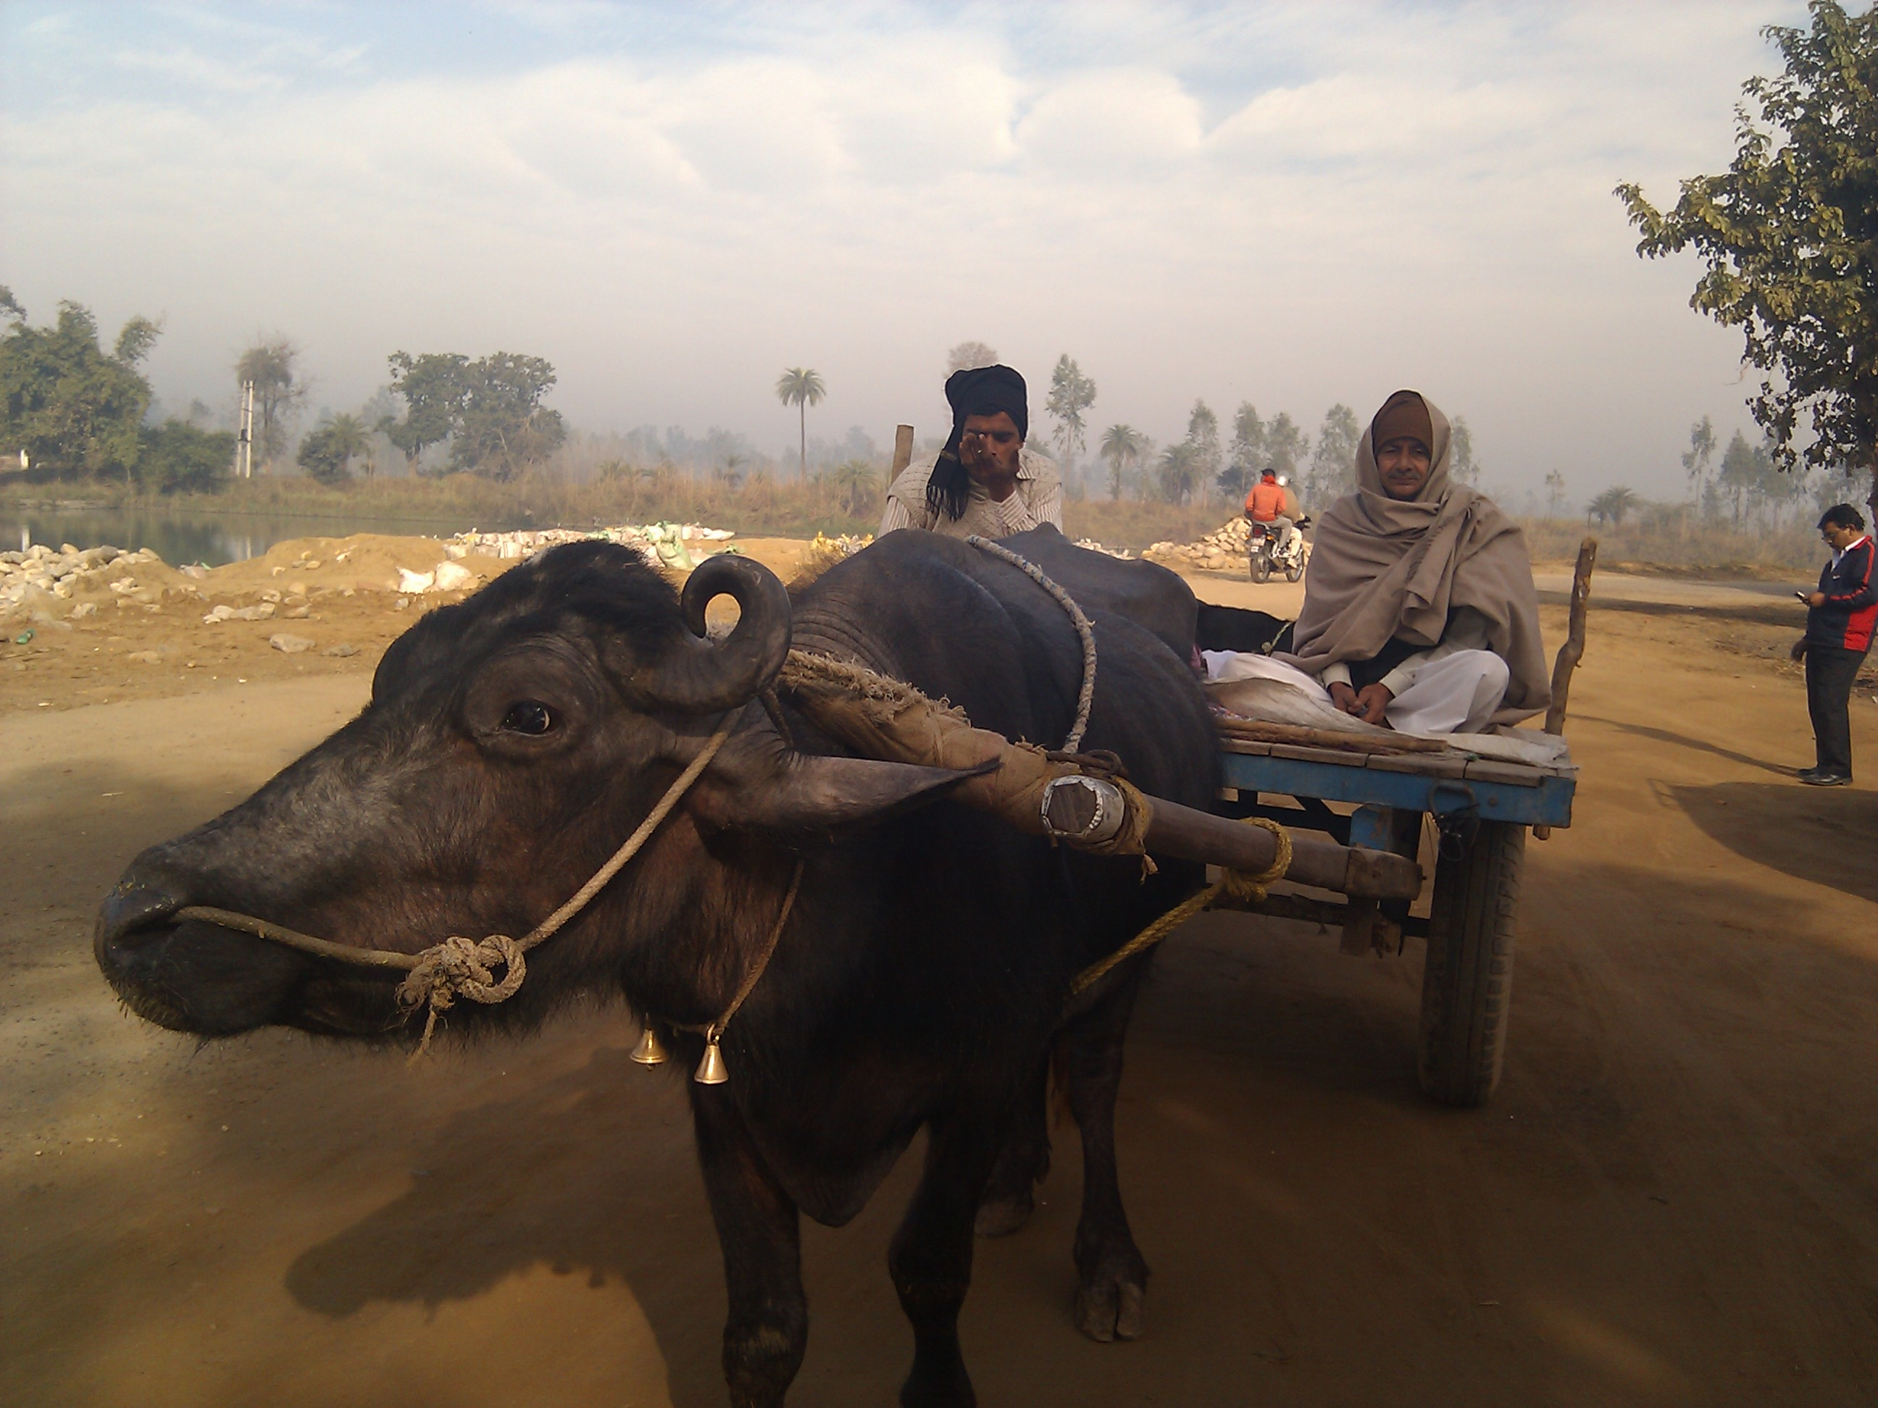
*Image
via
Bing

Slide 43
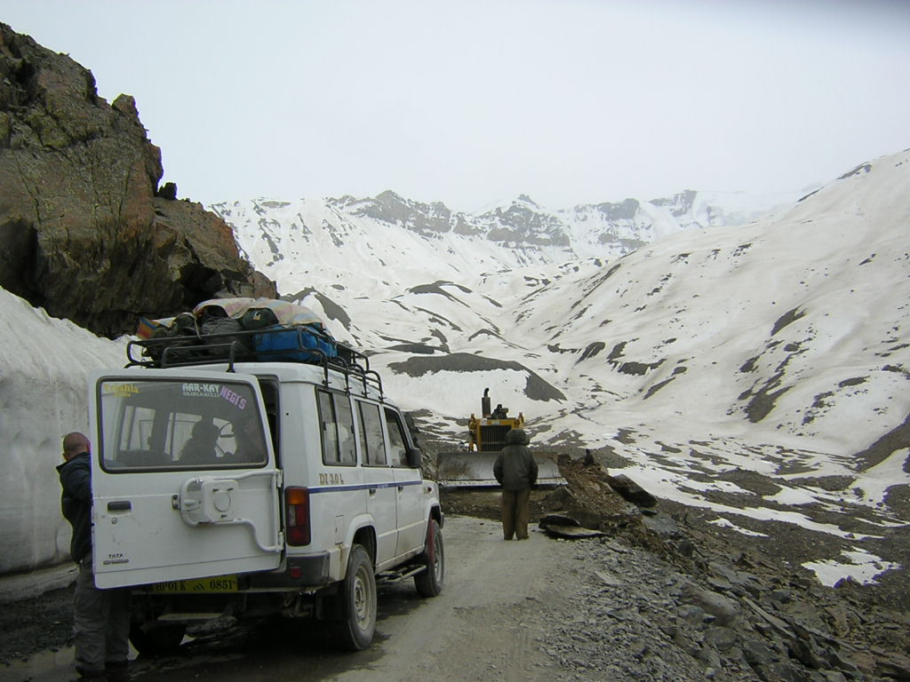
*Image
via
Bing

Slide 44
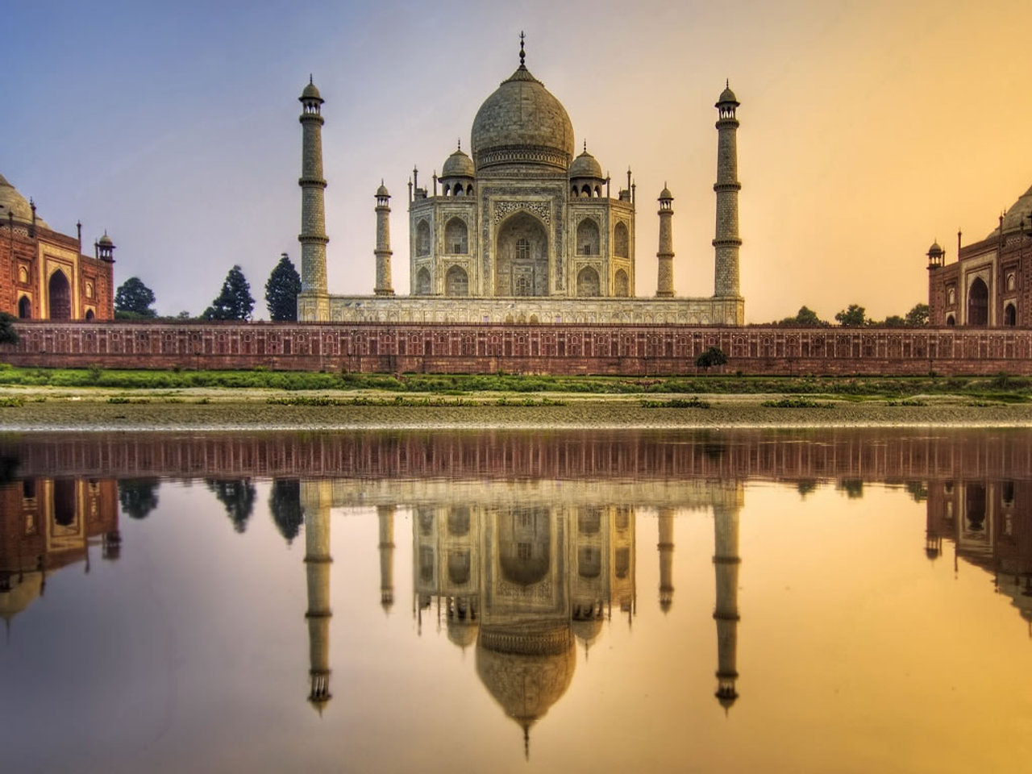
*Image
via
Bing

Slide 45
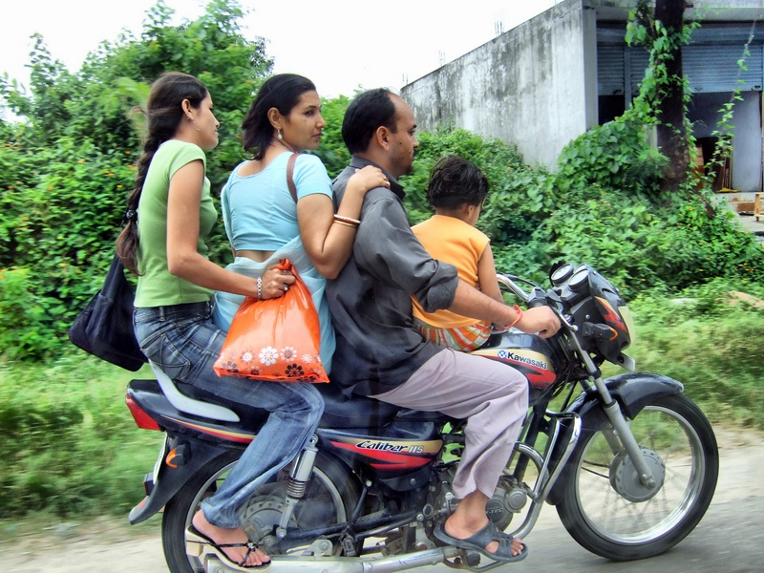
*Image
via
Bing

Slide 46
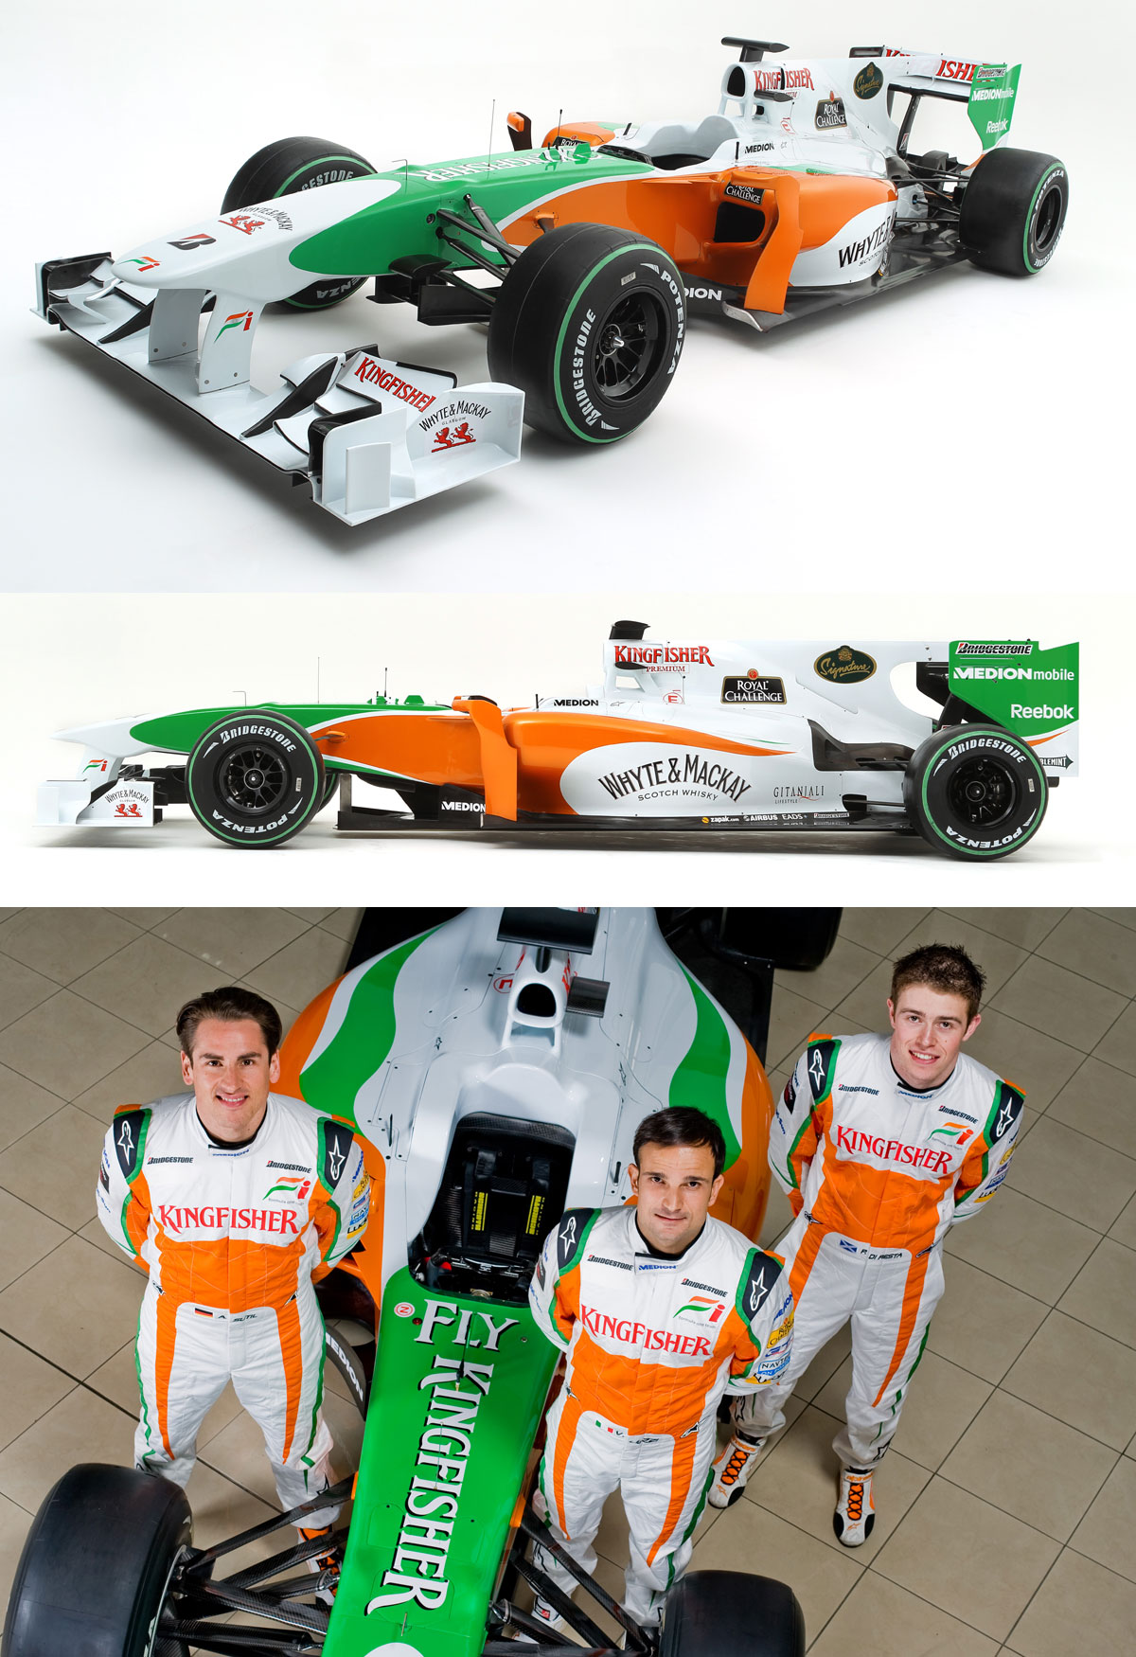
*Image
via
Bing

Slide 47
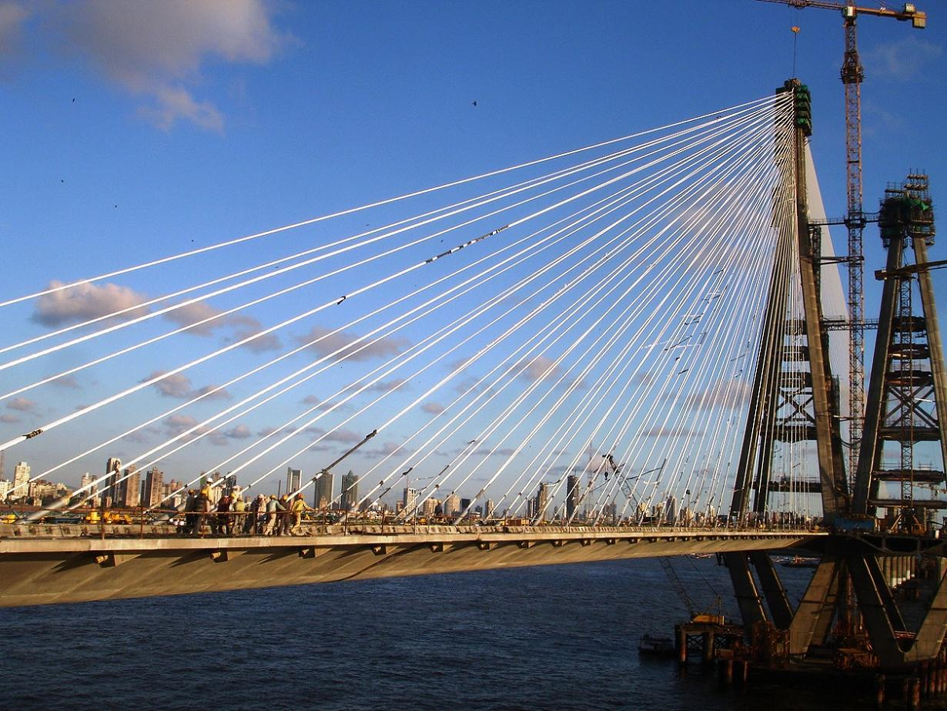
*Image
via
Bing

Slide 48
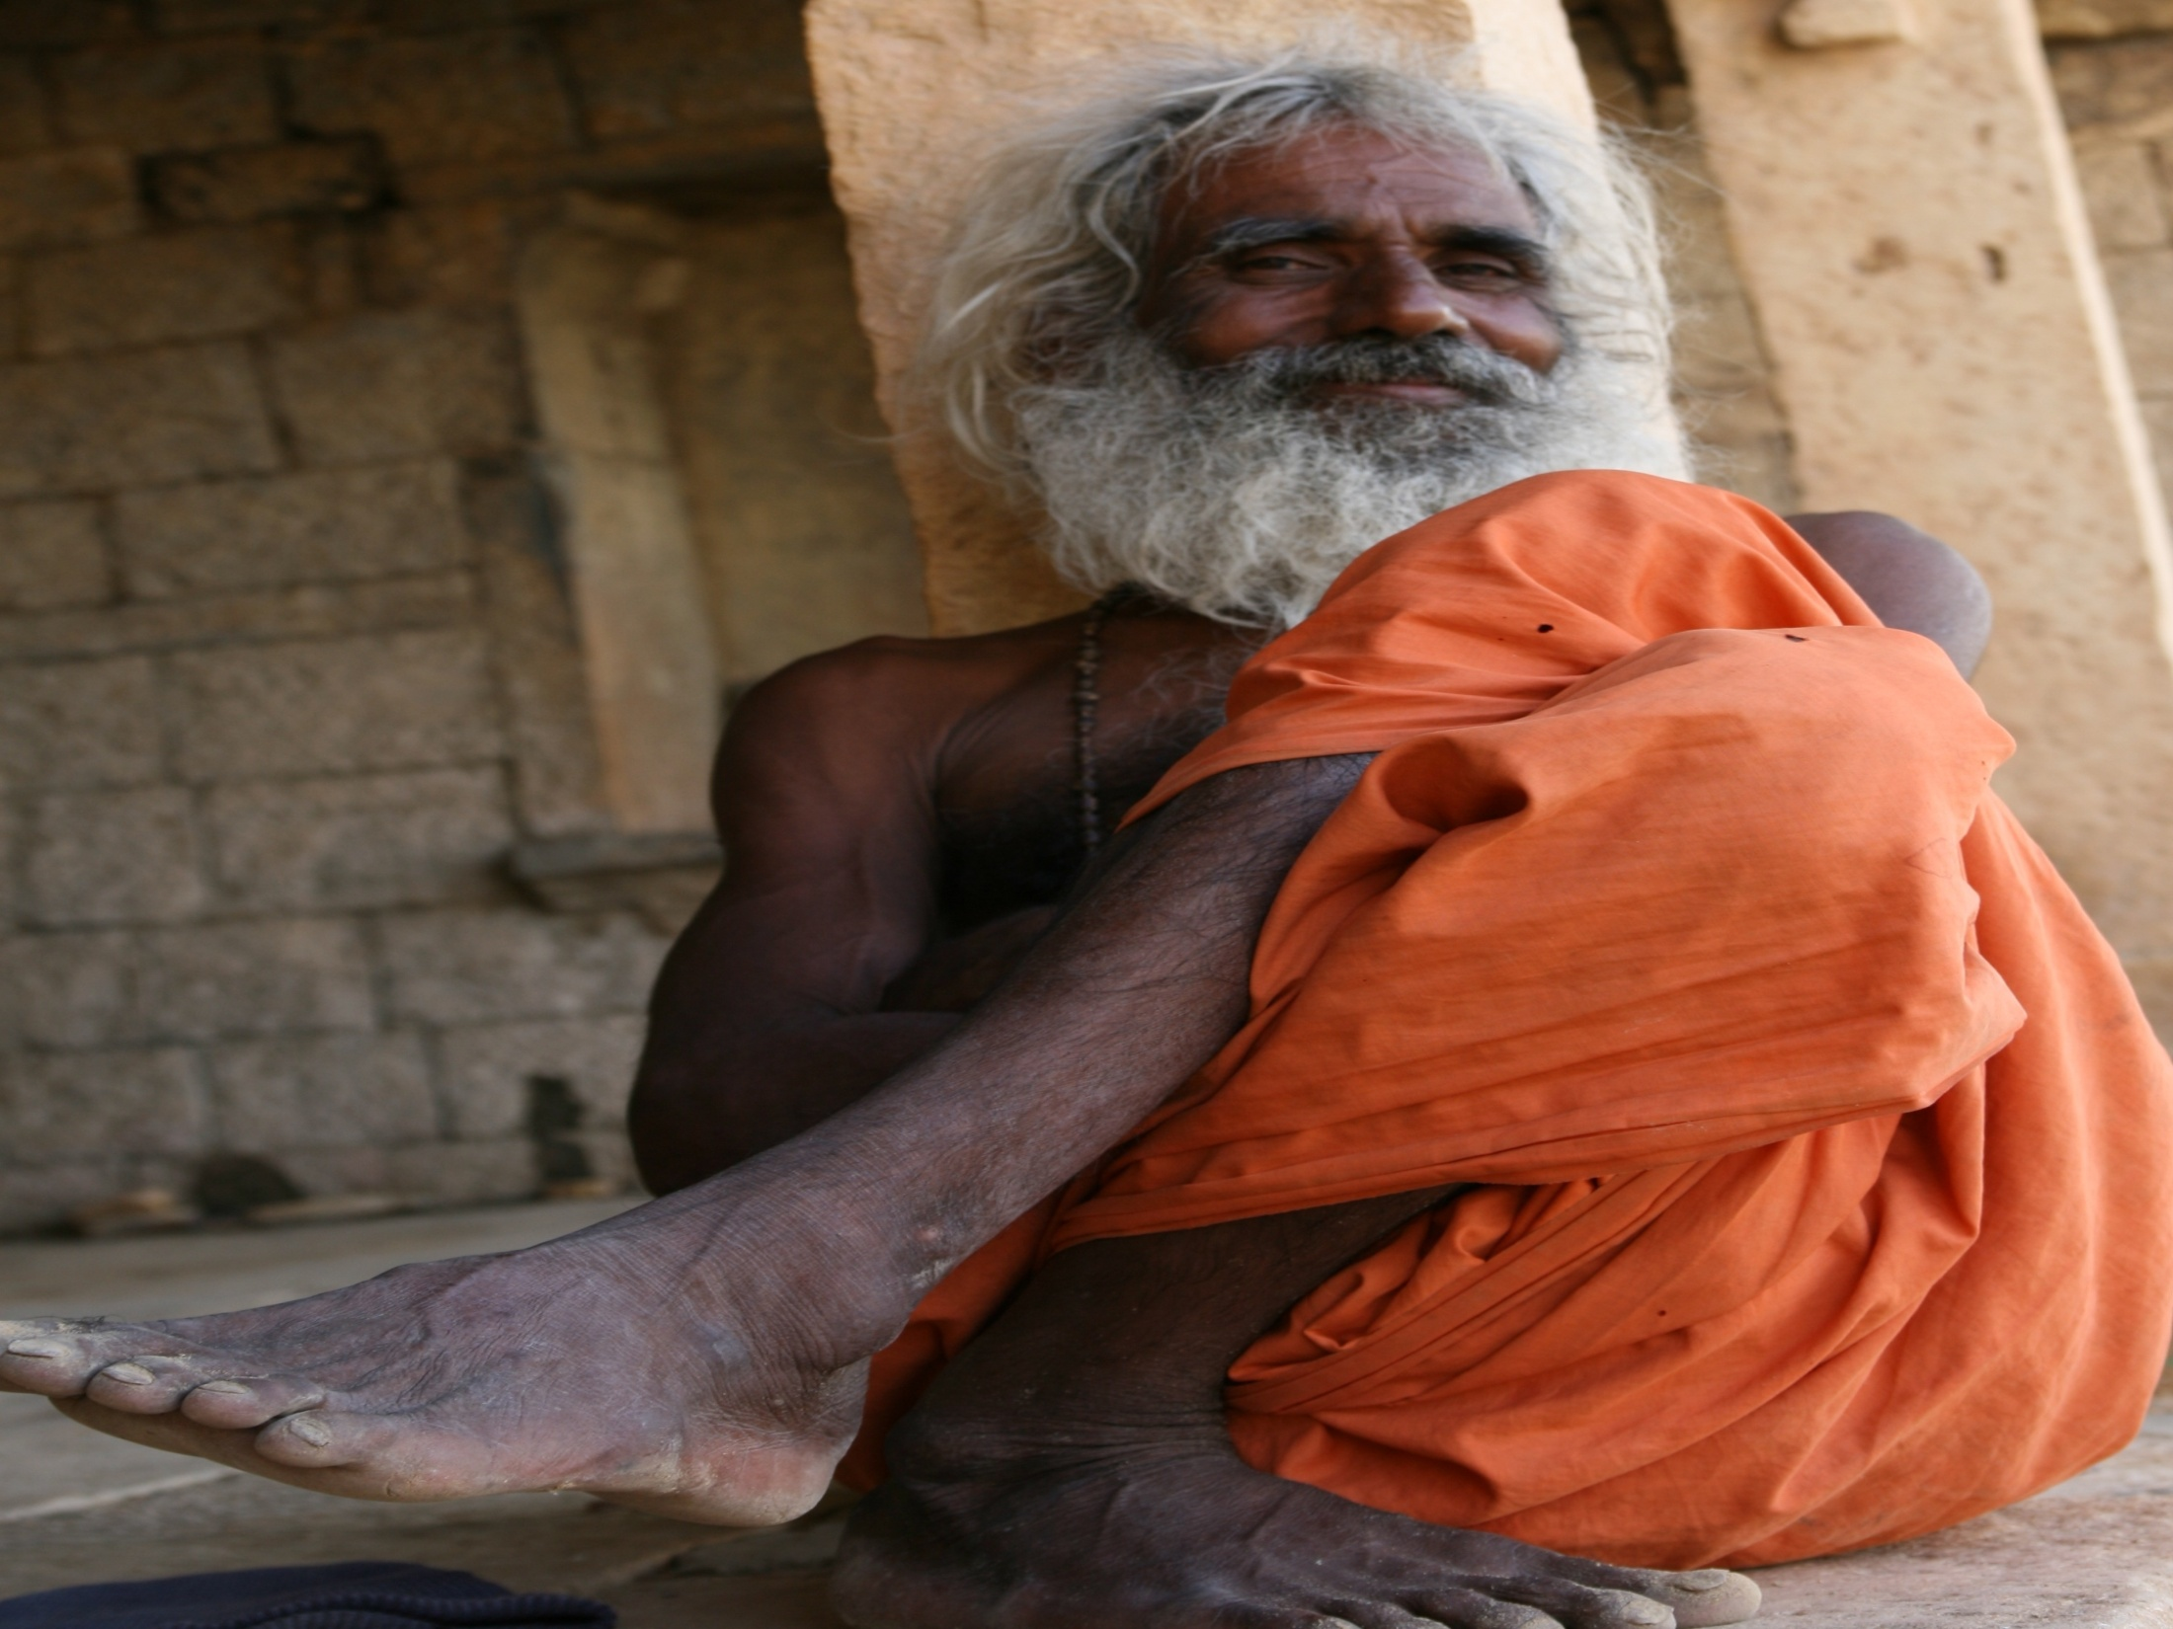
*Image
via
Bing

Slide 49
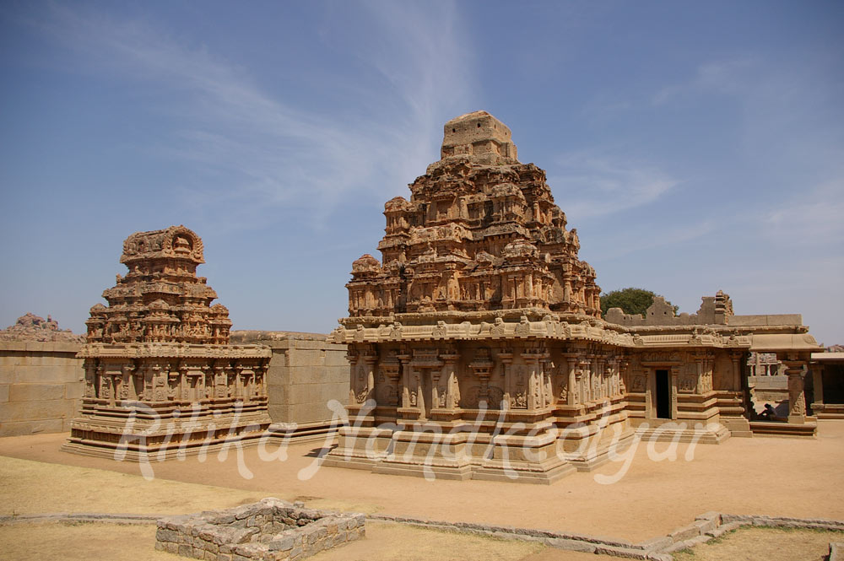
*Image
via
Bing

Slide 50
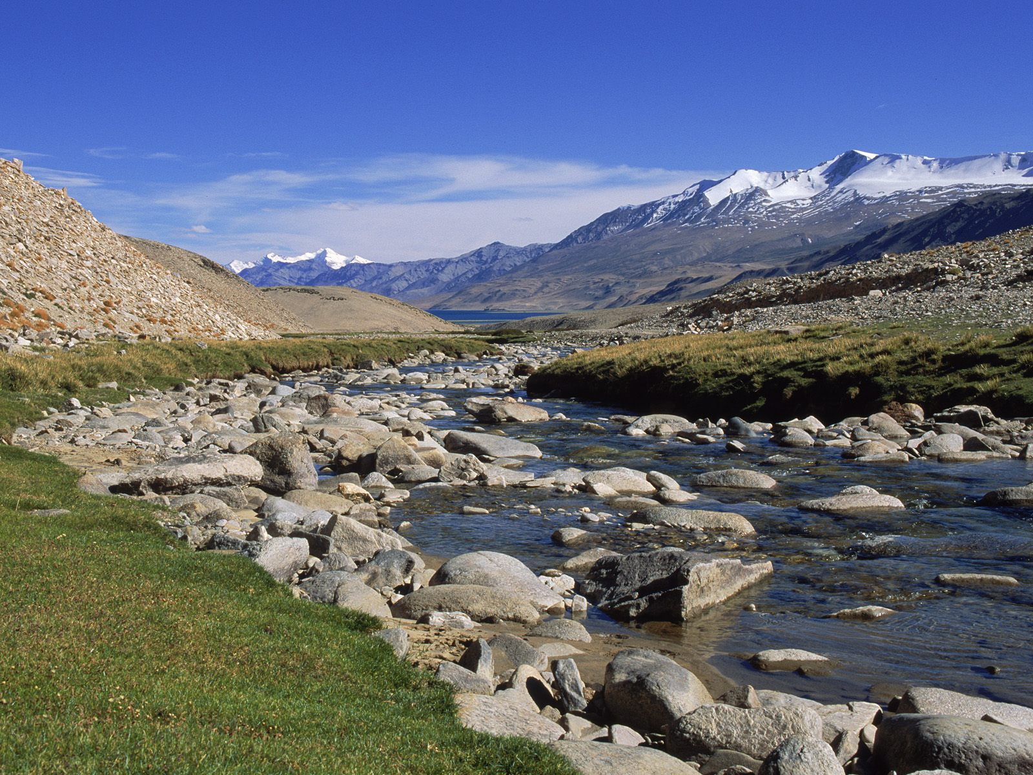
*Image
via
Bing

Slide 51


Slide 52
